Slide 1
بسم الله الرحمن الرحیم
Notes:
Introduce yourself
ان شاء الله که وخت خوب و پربرکت خواهیم داشت

Slide 2
JS101 Introduction to Web Programming with Javascript

Slide 3
Welcome
Notes:
Introduce yourself
ان شاء الله که وخت خوب و پربرکت خواهیم داشت

Slide 4
Agenda
Introduction
Course Structure
Algorithms
JavaScript

Slide 5
Introduction
Notes:
Name, education, experience
Ask student to introduce themselves? How many of them have prior programming experience? School or university?

Slide 6
Why JavaScript?

Slide 7





Slide 8










Slide 9
Course Structure
Notes:
teaching: only tells you how to do something
Training: correct your mistakes and guides you through each step.

Slide 10
Outline
Week1: Variables, conditionals, functions
Week 2: loops, arrays, strings
Week3: Objects, Error Handlign
Week4: DOM and Events
Week5: AJAX
Week6:SPA
Week7: ReactJS Intro
Week8: Thinking in React

Slide 11
Teaching vs Training
Notes:
teaching: only tells you how to do something
Training: correct your mistakes and guides you through each step.

Slide 12
عالم بی عمل – درخت بی ثمر
Notes:
Our teaching philosophy: learn by doing.
چطور در یک شهر نو بلد میشوید.
اول چیز های را یاد بگیر که زیاد سروکار داشته باشی همرایش.
Course suggestion: learning how to learn on Coursera.

Slide 13
Computer Science
Notes:
Introduce yourself
ان شاء الله که وخت خوب و پربرکت خواهیم داشت

Slide 14
input →
Process
→ output
Notes:
Representations: counting on hand, counting with decimal, but computers only have 0s and 1s
Basically computer does 5 basic operations that are input, output, process, storing and controlling.

Slide 15
🖐️

Slide 16
123

Slide 17
1
123

Slide 18
10
1
123

Slide 19
100
10
1
123

Slide 20
100
10
1
123
100 × 1

Slide 21
100
10
1
123
100 × 1
+
10 × 2

Slide 22
100
10
1
123
100 × 1
+
10 × 2
+
1 × 3

Slide 23
100
10
1
123
100
+
20
+
3

Slide 24
123

Slide 25
100
10
1
# # #
Notes:
But why 1, 10, and 100?

Slide 26
10²
10¹
10⁰
# # #

Slide 27
2²
2¹
2⁰
# # #

Slide 28
4
2
1
# # #

Slide 29
4
2
1
000

Slide 30
4
2
1
001

Slide 31
4
2
1
010

Slide 32
4
2
1
011

Slide 33
4
2
1
100

Slide 34
4
2
1
101

Slide 35
4
2
1
110

Slide 36
4
2
1
111

Slide 37
A

Slide 38
65

Slide 39
01000001

Slide 40
ASCII

Slide 41
... | A | B | C | D | E | F | G | H | I | ...
... | 65 | 66 | 67 | 68 | 69 | 70 | 71 | 72 | 73 | ...

Slide 42
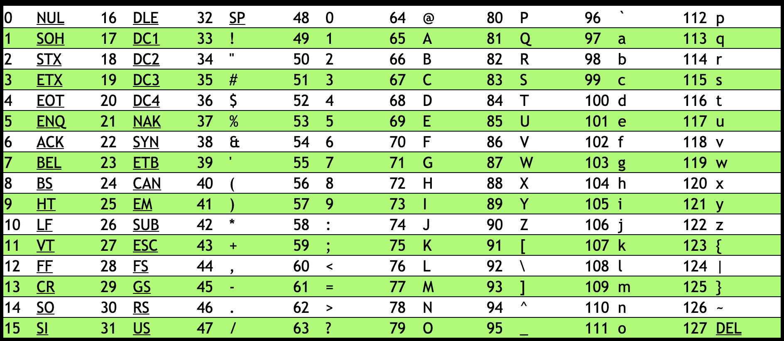
Notes:
https://asciichart.com/

Slide 43
H | I | !
72 | 73 | 33

Slide 44
H | I | !
01001000 | 01001001 | 00100001
Notes:
bytes

Slide 45
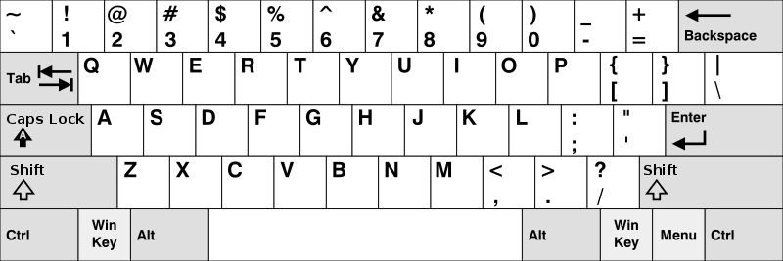
Notes:
https://en.wikipedia.org/wiki/British_and_American_keyboards
But how to represent other symbols?

Slide 46
Unicode

Slide 47
Notes:
Should be #484921ff, but brightened for projectors.

Slide 48
RGB

Slide 50
72 | 73 | 33

Slide 51


Slide 52


Slide 53


Slide 54

Notes:
https://youtu.be/p3q9MM__h-M

Slide 55
input →
→ output

Slide 56
algorithm

Slide 57
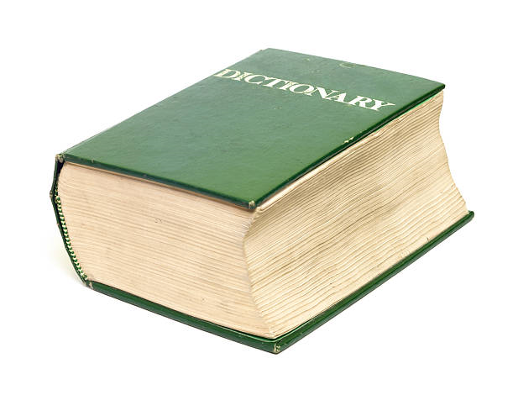
Notes:
https://apps.apple.com/us/app/contacts/id1069512615#?platform=iphone

Slide 58
pseudocode

Slide 59
1 Pick up dictionary
2 Open to middle of dictionary
3 Look at page
4 If word is on page
5 Read the Definition
6 Else if word is earlier in dictionary
7 Open to middle of left half of dictionary
8 Go back to line 3
9 Else if word is later in dictionary
10 Open to middle of right half of dictionary
11 Go back to line 3
12 Else
13 Quit

Slide 60
1 Pick up dictionary
2 Open to middle of dictionary
3 Look at page
4 If word is on page
5 Read the Definition
6 Else if word is earlier in dictionary
7 Open to middle of left half of dictionary
8 Go back to line 3
9 Else if word is later in dictionary
10 Open to middle of right half of dictionary
11 Go back to line 3
12 Else
13 Quit

Slide 61
1 Pick up dictionary
2 Open to middle of dictionary
3 Look at page
4 If word is on page
5 Read the Definition
6 Else if word is earlier in dictionary
7 Open to middle of left half of dictionary
8 Go back to line 3
9 Else if word is later in dictionary
10 Open to middle of right half of dictionary
11 Go back to line 3
12 Else
13 Quit

Slide 62
1 Pick up dictionary
2 Open to middle of dictionary
3 Look at page
4 If word is on page
5 Read the Definition
6 Else if word is earlier in dictionary
7 Open to middle of left half of dictionary
8 Go back to line 3
9 Else if word is later in dictionary
10 Open to middle of right half of dictionary
11 Go back to line 3
12 Else
13 Quit

Slide 63
1 Pick up dictionary
2 Open to middle of dictionary
3 Look at page
4 If word is on page
5 Read the Definition
6 Else if word is earlier in dictionary
7 Open to middle of left half of dictionary
8 Go back to line 3
9 Else if word is later in dictionary
10 Open to middle of right half of dictionary
11 Go back to line 3
12 Else
13 Quit

Slide 64
1 Pick up dictionary
2 Open to middle of dictionary
3 Look at page
4 If word is on page
5 Read the Definition
6 Else if word is earlier in dictionary
7 Open to middle of left half of dictionary
8 Go back to line 3
9 Else if word is later in dictionary
10 Open to middle of right half of dictionary
11 Go back to line 3
12 Else
13 Quit

Slide 65
functions
arguments, return values
conditionals
Boolean expressions
loops
variables
...

Slide 66
Let dictionary;

Slide 67
function pickup()
{
}

Slide 68
if()
{
}
else
{
}

Slide 69
While()
{
}

Slide 70
Source Code →
→ machine code

Slide 71
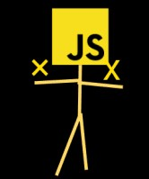
Source Code →
→ machine code

Slide 72
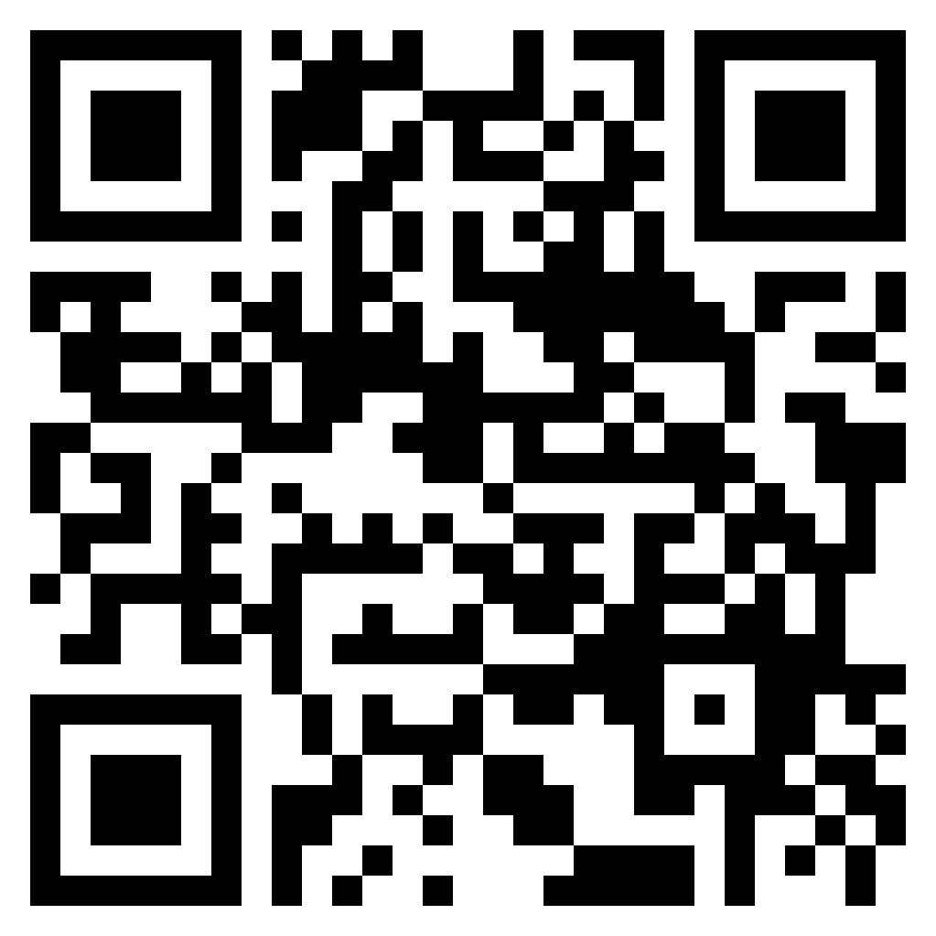
Whatsapp group link

Slide 73
Tasks
1. install vscode
2. install nodejs
3. create github account
4. install git bash on your pc
5. watch a video on git and github

